Slide 1
CSE 145: Brilliant Pad Poo Vision
Final Oral Presentation
Richard Chum, Derek Lam, Kevin Tain
Notes:
Funny intro
Bestfriend’s poo?

Slide 2
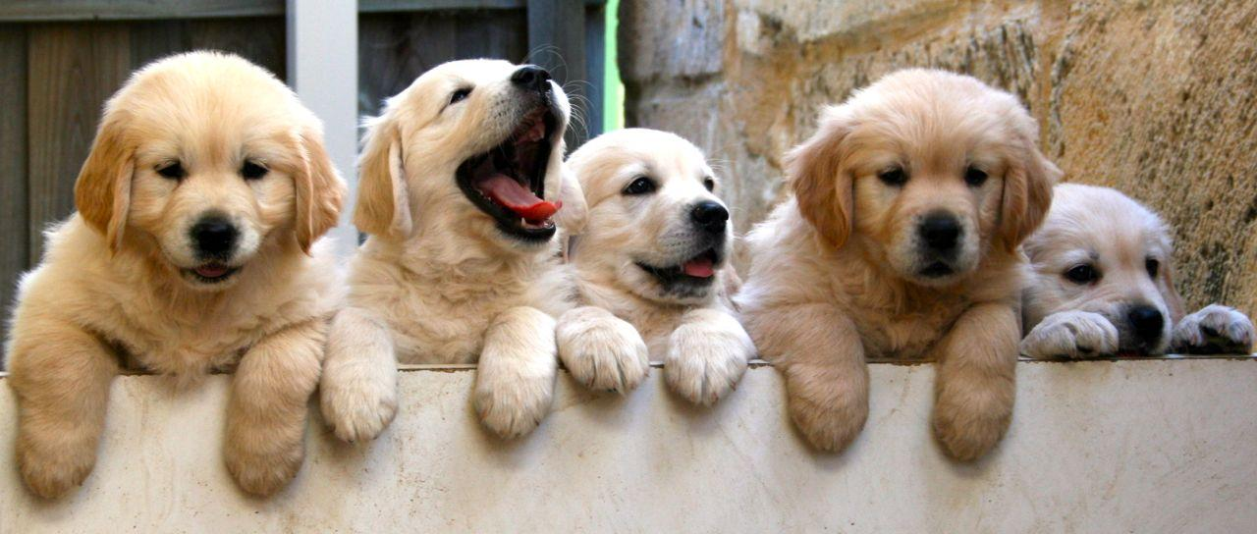
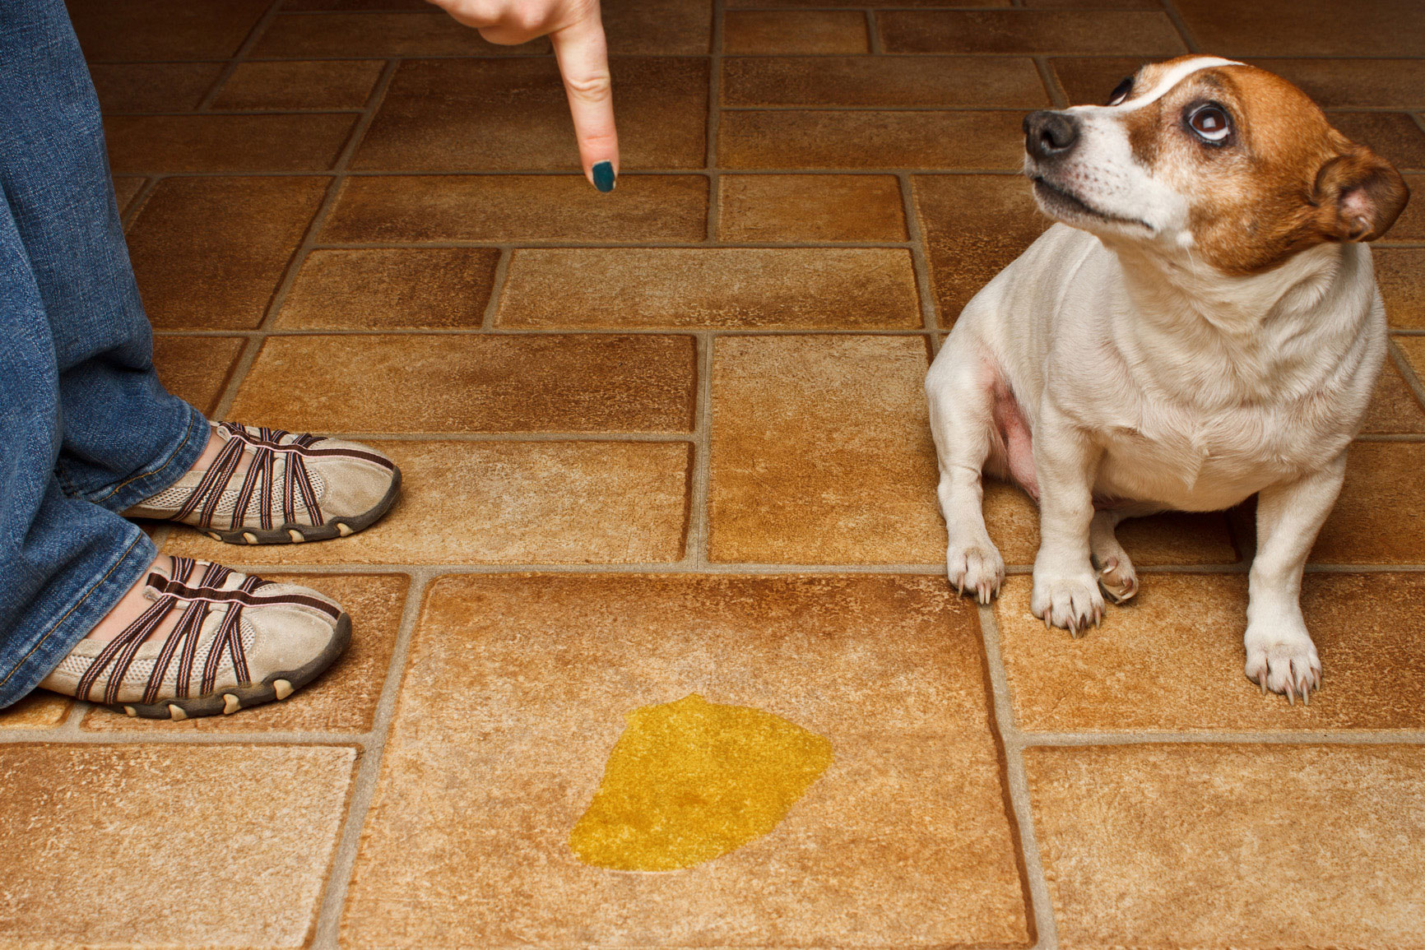
Notes:
MANS BEST FRIEND
THEY STILL GO TO THE RESTROOM AND YOU HAVE TO CLEAN IT, BUT YOU THINK IT’S GROSS. THEREFORE WE BRING YOU BRILLIANT PAD

Slide 3
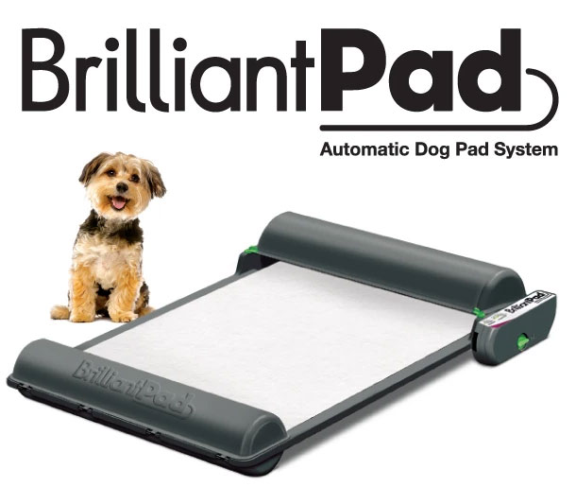
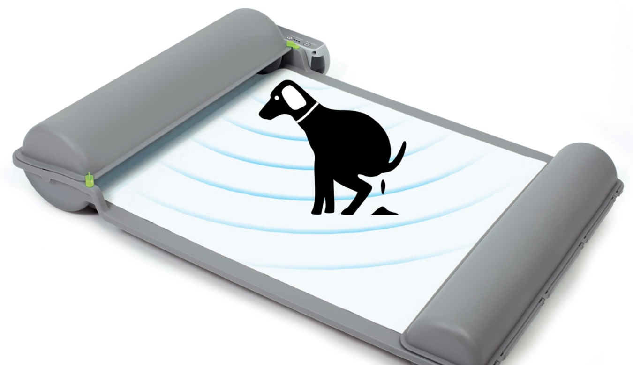
Introducing:
Notes:
Introduce the Brilliant Pad product and its current vision system

Slide 4
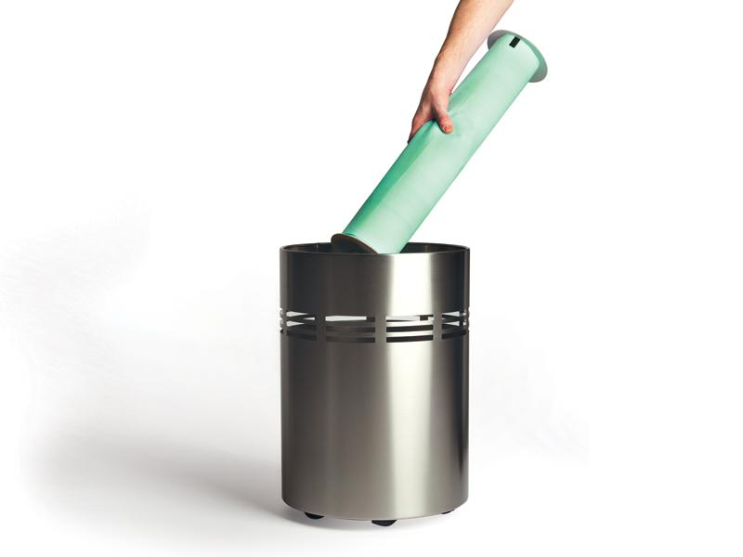
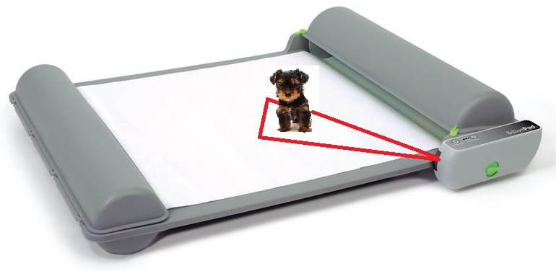
Current Limitation
Limited Vision
Early advancement of pad
Notes:
Talk about the limitations and issues with the brilliant pad

Slide 5
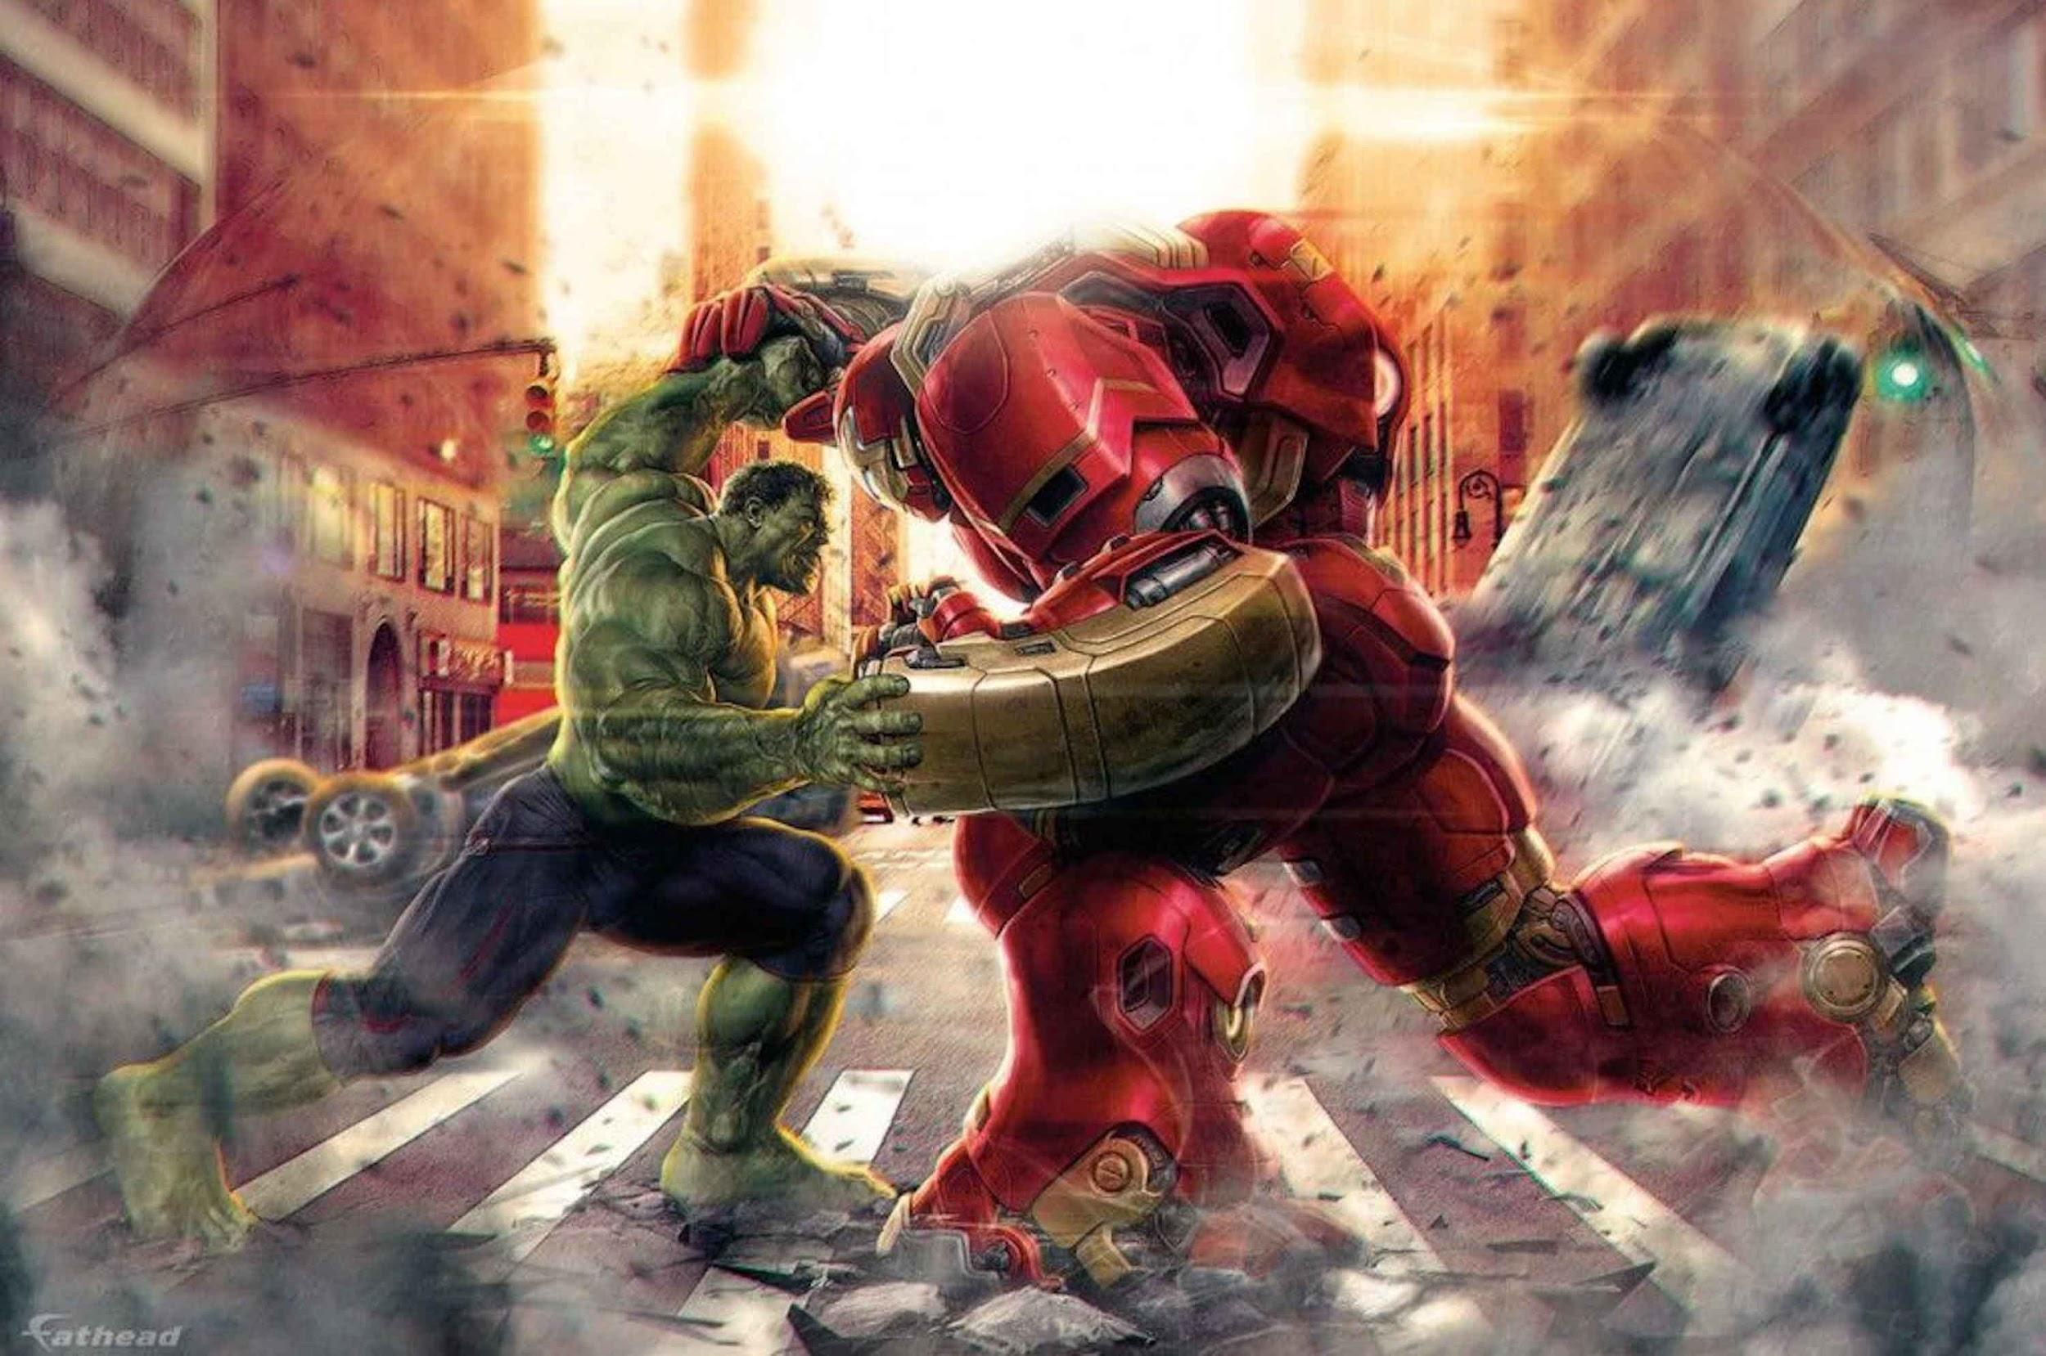
Poo Vision to the Rescue
Notes:
Adding tech to combat your greatest problem
Detect dog
Detect amount of waste

Slide 6
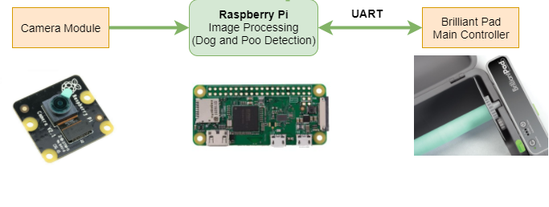
Enhancements
Notes:
How dirty is the pad
Improving how we detect the dog

Slide 7

Down and Dirty with the Details
Algorithms:
Blob detection
Differential Images

Slide 8
Determining Soil Level
Normal Lighting
Low Light

Slide 9
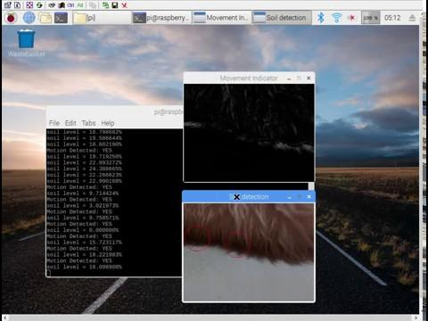
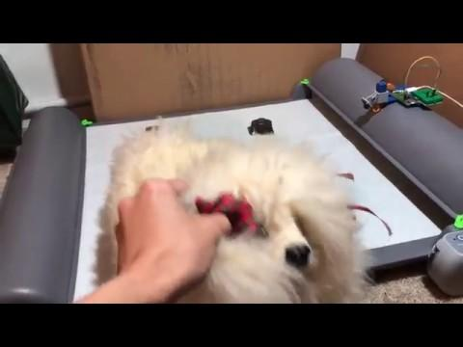
Dog Detection

Slide 10
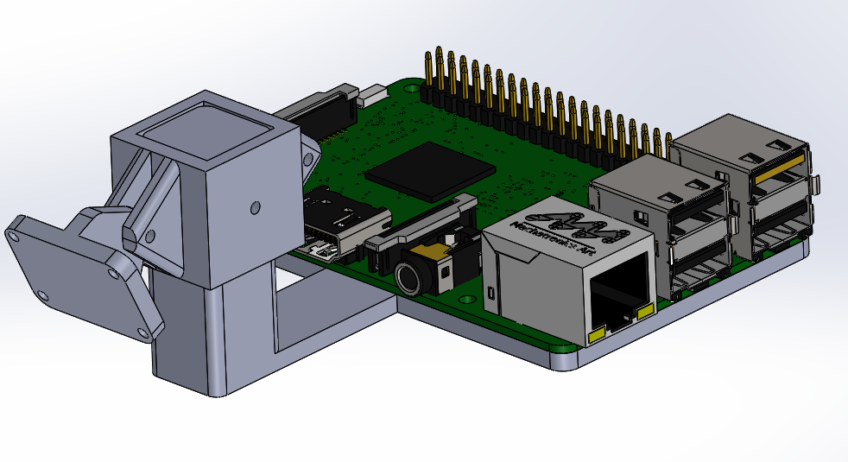
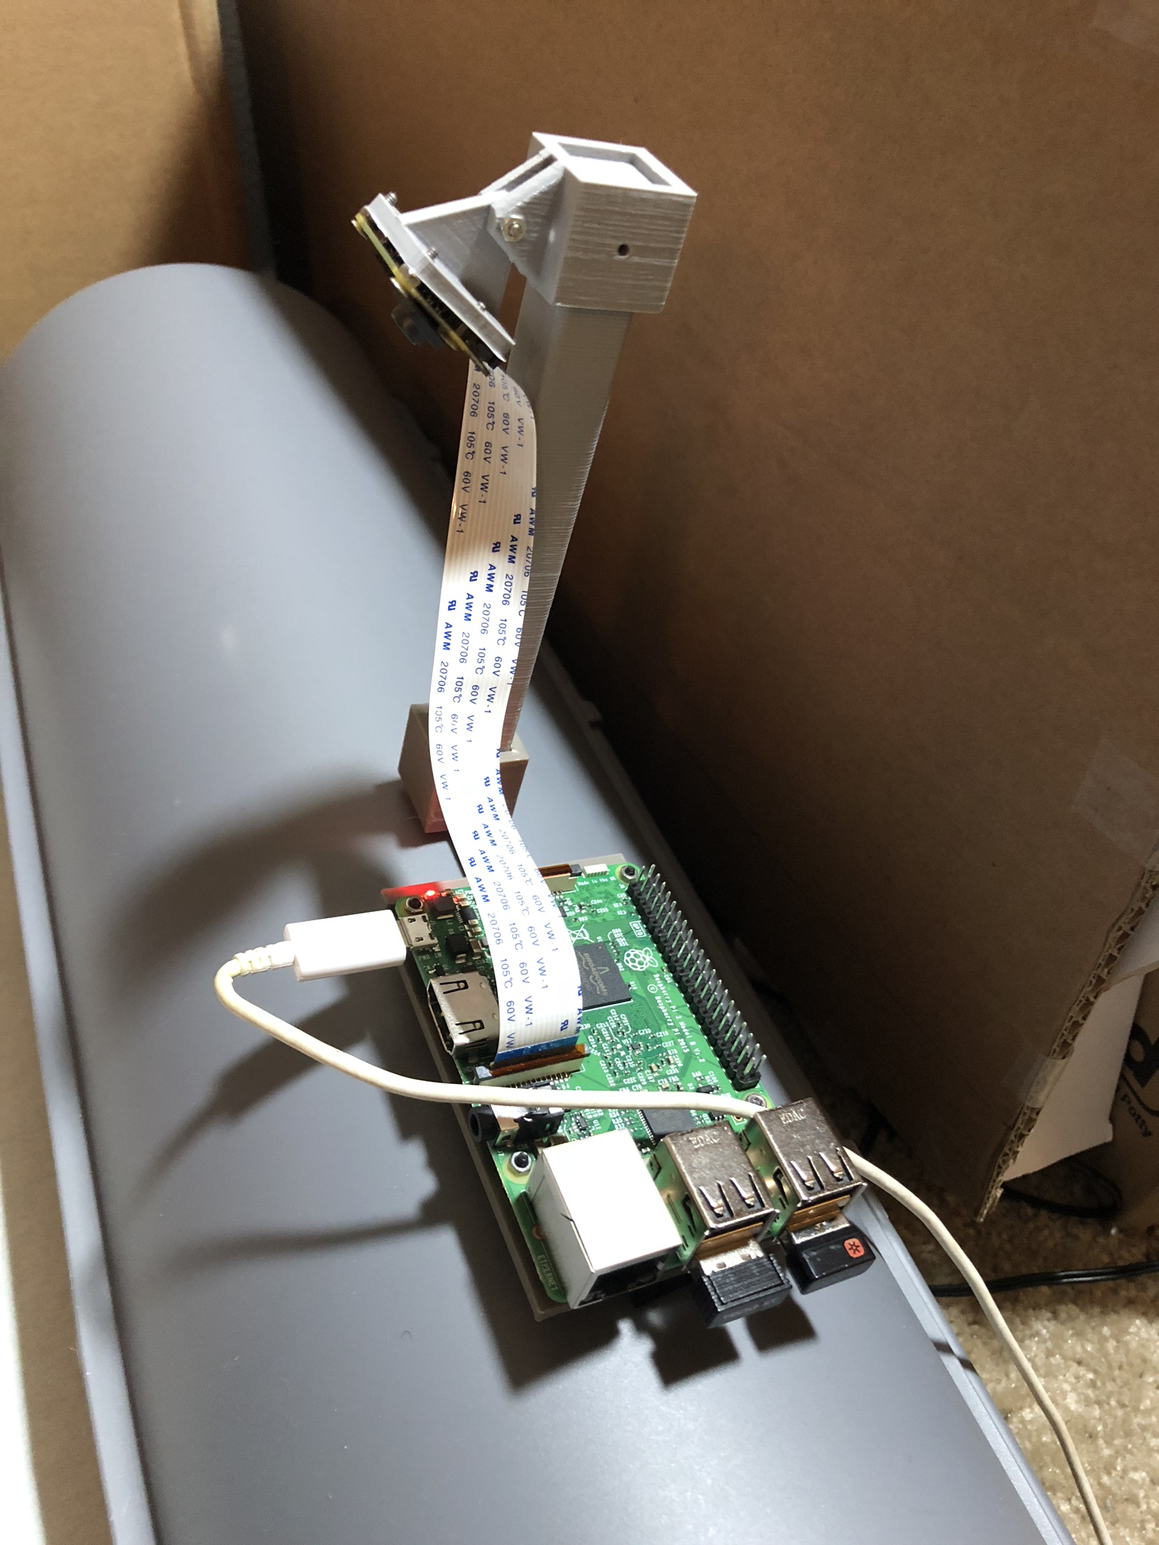
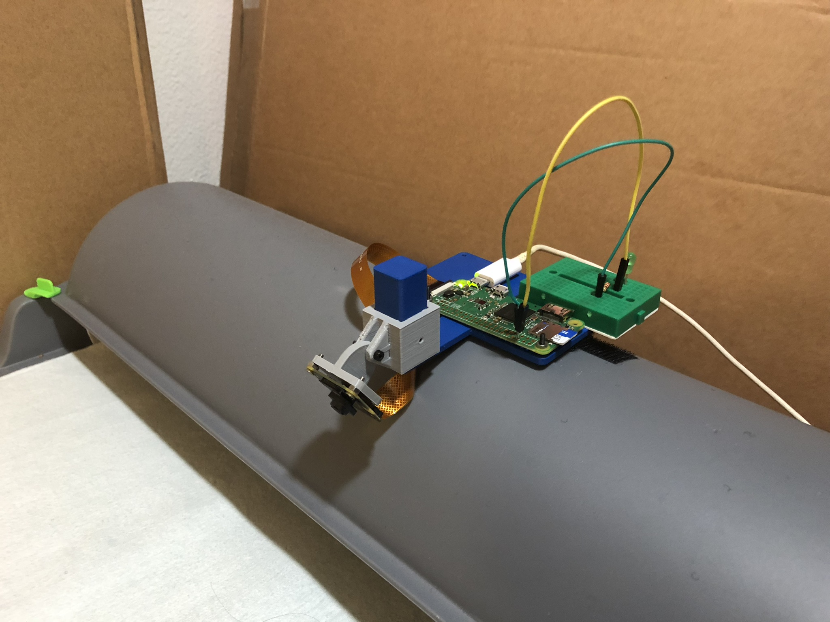
Mechanical Design

Slide 11
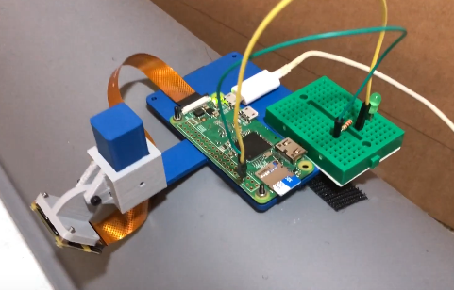
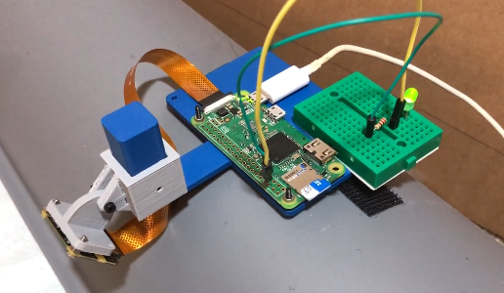
Demonstration with LED indicator
LED Off = Not ready to advance
LED On = Ready to advance

Slide 12
Demonstration with LED indicator

Slide 13
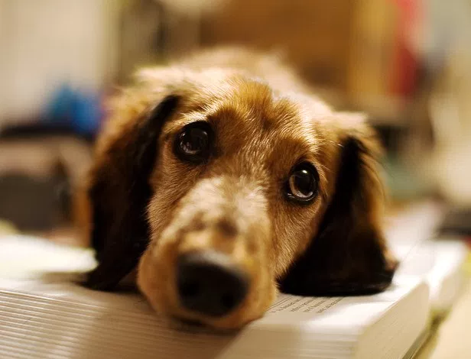
Notes:
detecting pee
shadows detected as waste
night vision (include picture of night image)
limitations with seeing the entire pad

Slide 14
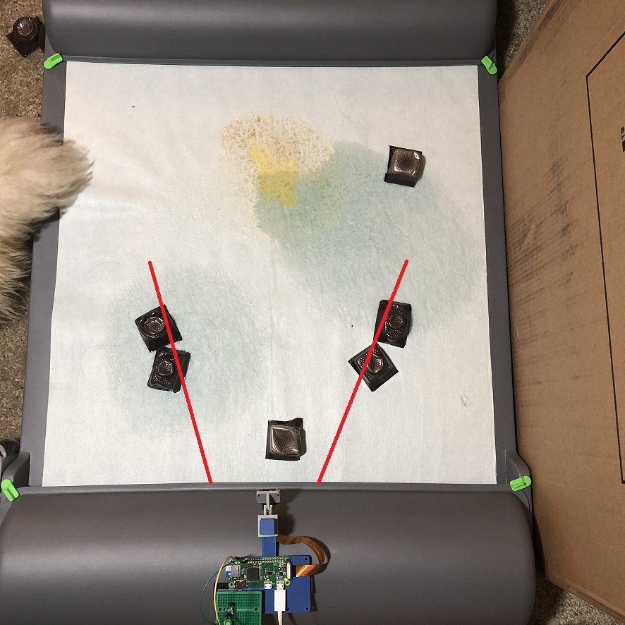
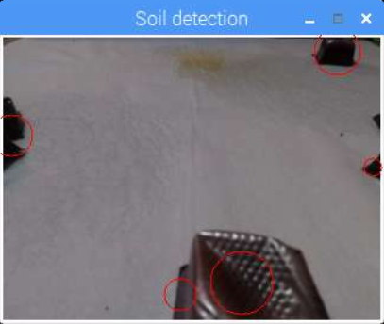
Limited View + Camera Quality

Slide 15
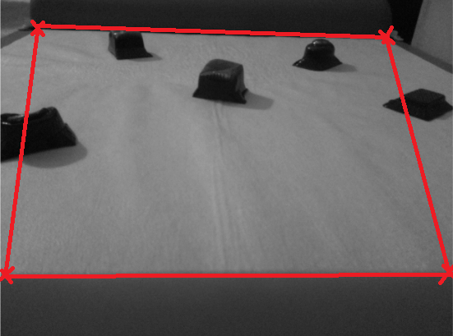
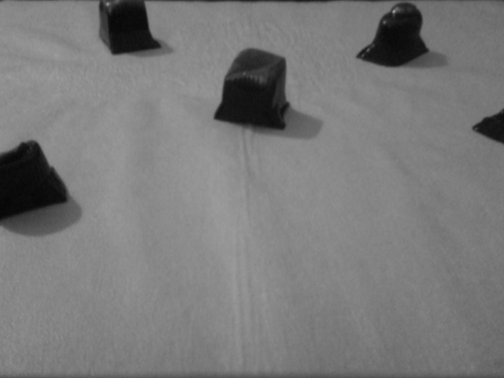
Image Transformation
Original
Transformed
Notes:
warping the image causes us to see even less of the pad, because you need a view of all 4 corners to properly transform

Slide 16
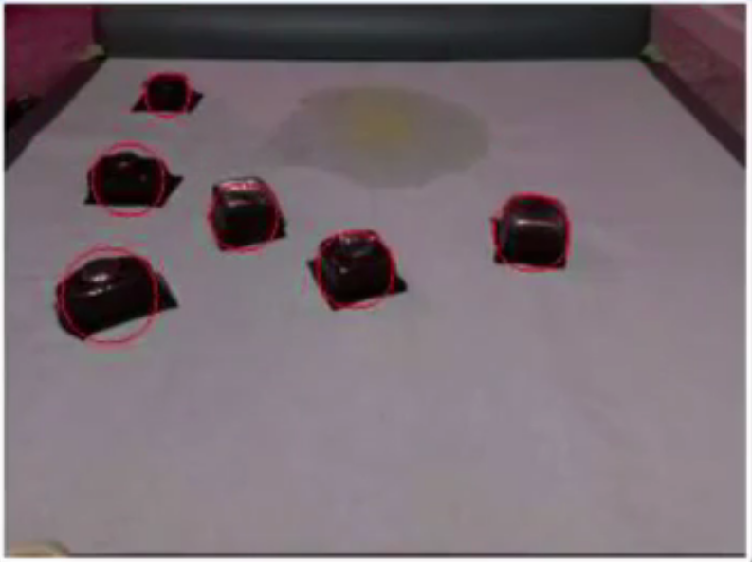
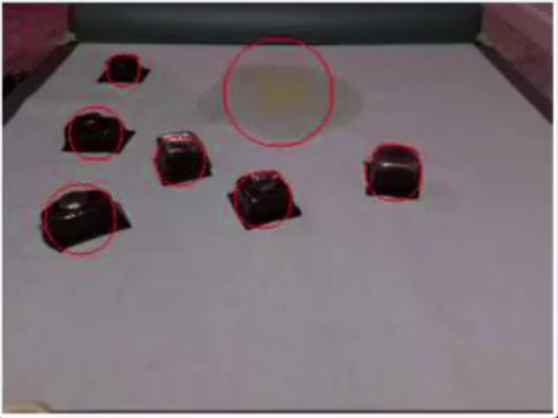
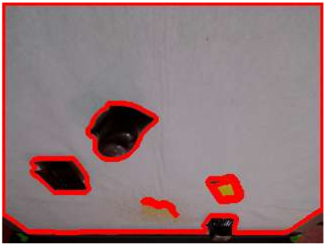
Pee Detection

Slide 17
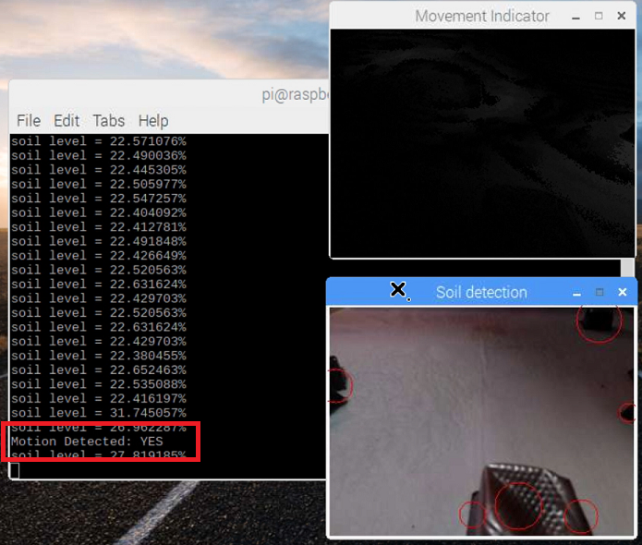
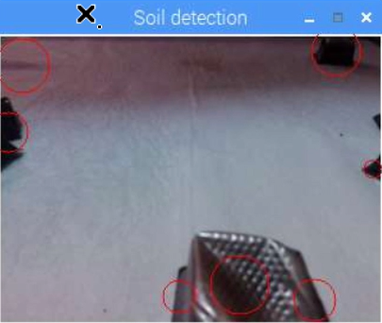
Shadows
Detected as Motion
Detected as Waste

Slide 18
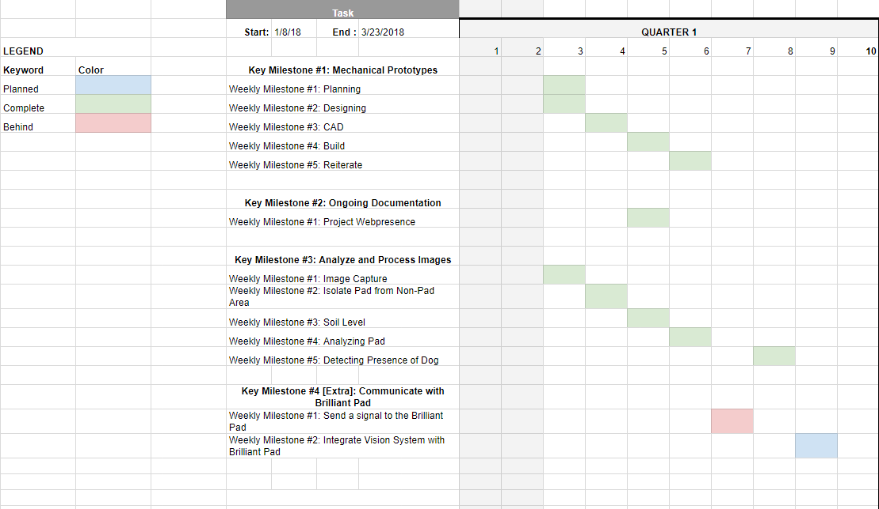
Future Projects

Slide 19
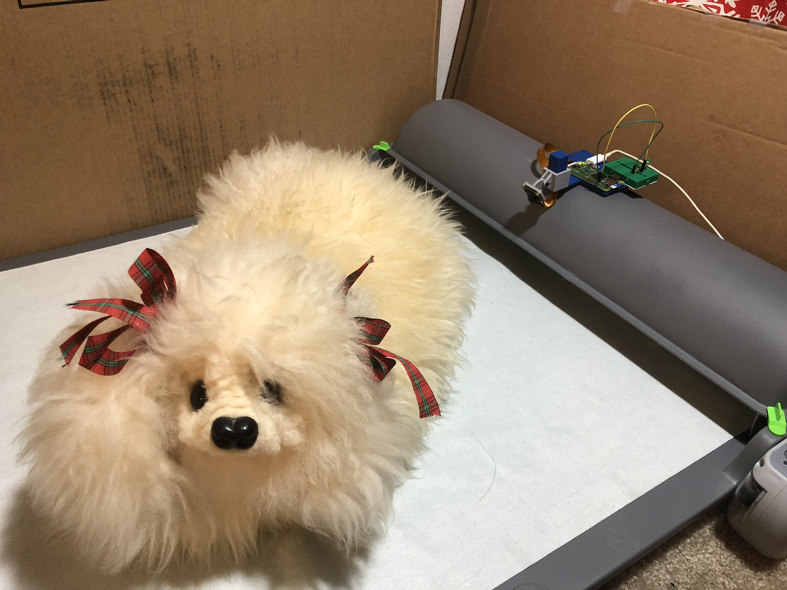
Conclusion
Notes:
Helping out your BEST FRIEND

